Slide 1
SALARY PREDICTION
Submitted by- Group 6

Slide 2
Abstract
Human resources (HR) is the division of an organization that is responsible for finding, screening,
recruiting, and training job applicants, and administering employee-benefit programs.
This management is the strategic approach to the efficient management of people in any
organization in a way that can help their business gain a competitive advantage. It is designed to
improve employee performance in service of an employer's strategic objectives.
Understanding the Problem Statement :-
Here we are going to analyze the salary variation based on age, Experience, total, education etc and predict the salary distribution of each employee in the firm.

Slide 3
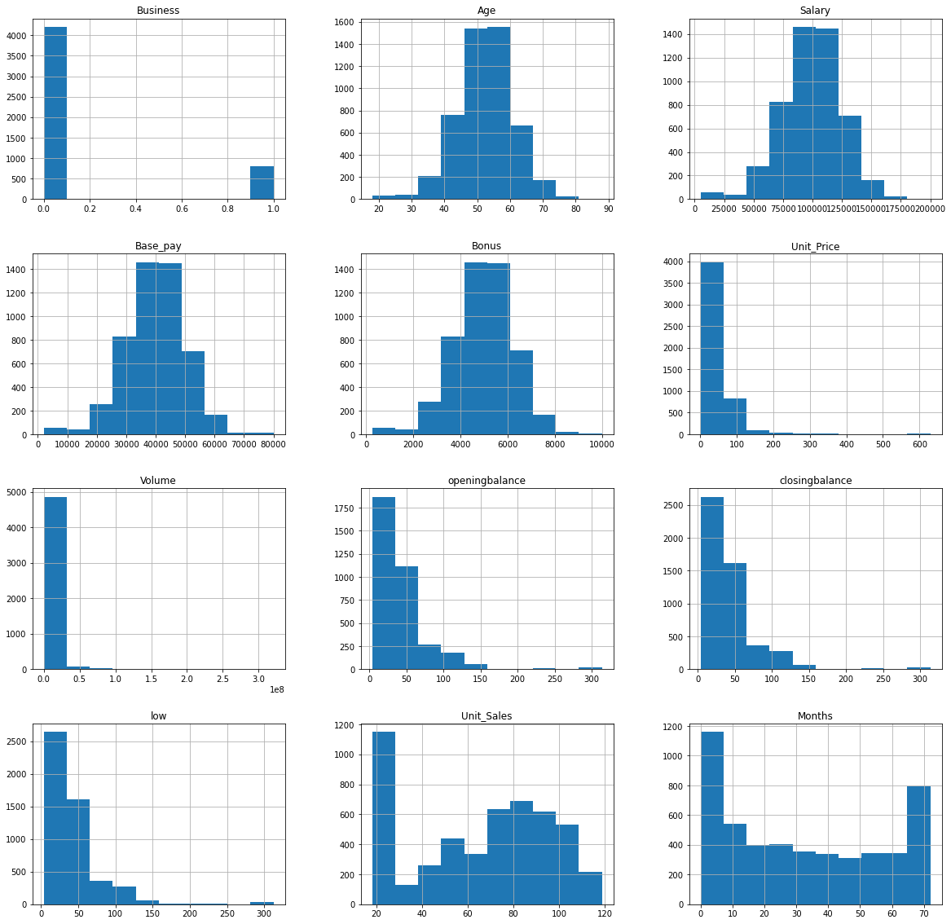
Univariate Analysis

Slide 4
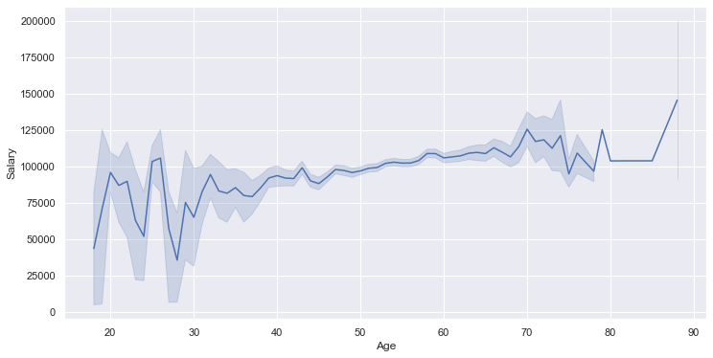
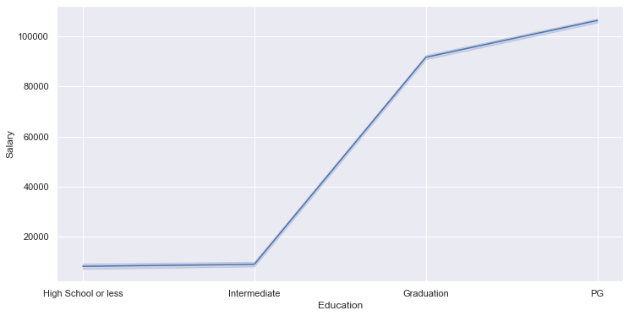
Bivariate Analysis
Age vs Salary
Education vs Salary
We can see that, age ranging from 40 to 70 shows no much variation in the salary, whereas the age gap between 15 and 33 shows greater variations in the salary
Here we observe that, there is drastic increase in salary when education is between Intermediate and Graduation, and least change in salary when the education is below intermediate.

Slide 5
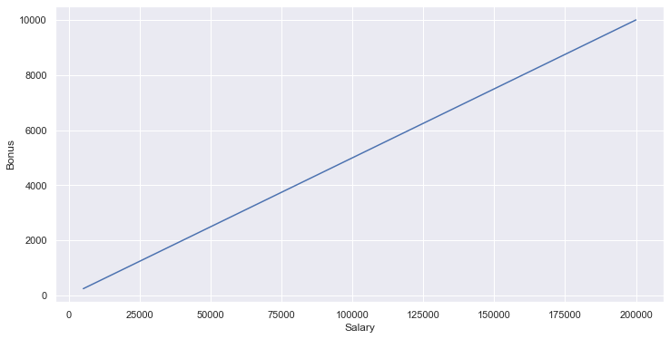
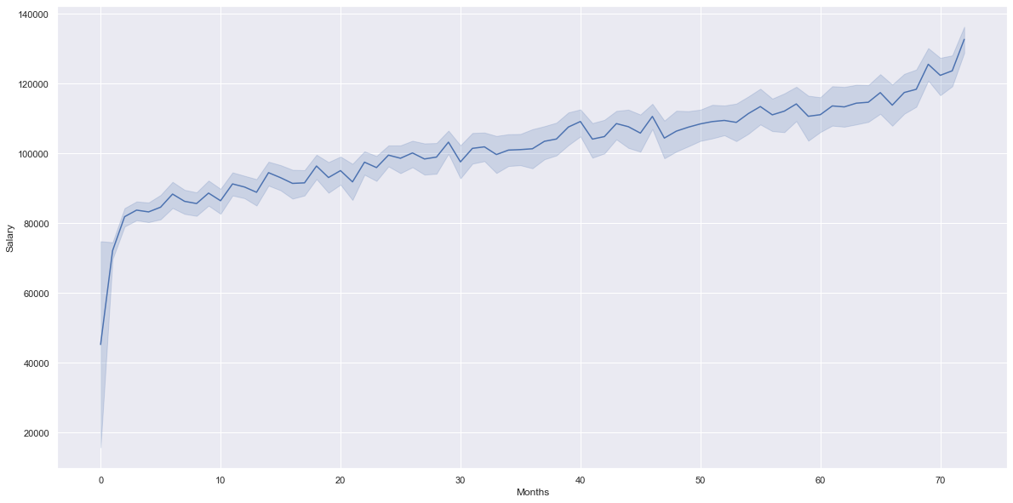
Bivariate Analysis- continued
Bonus Pay vs Salary
Experience vs Salary
We observe that the bonus paid is directly proportional to the salaries.
There is a commendable hike in salary for newly joined and for the experienced employee.
Also we can observe that, there is only a slight change in salary for the employees who stay.

Slide 6
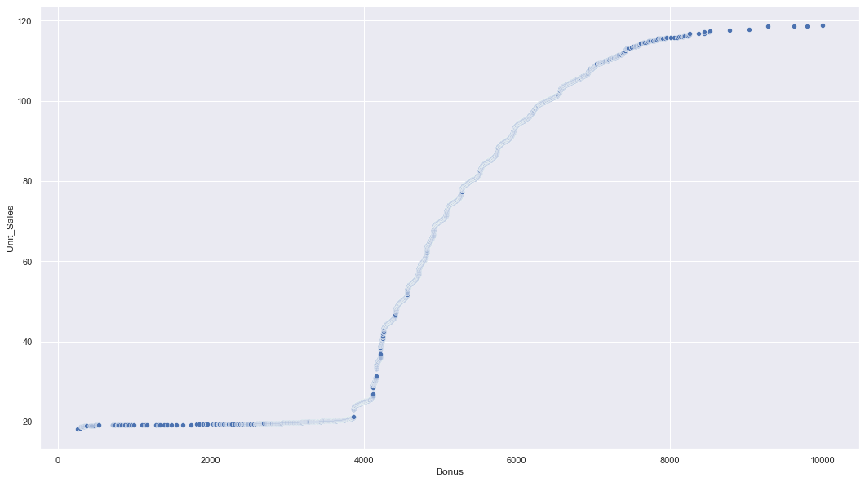
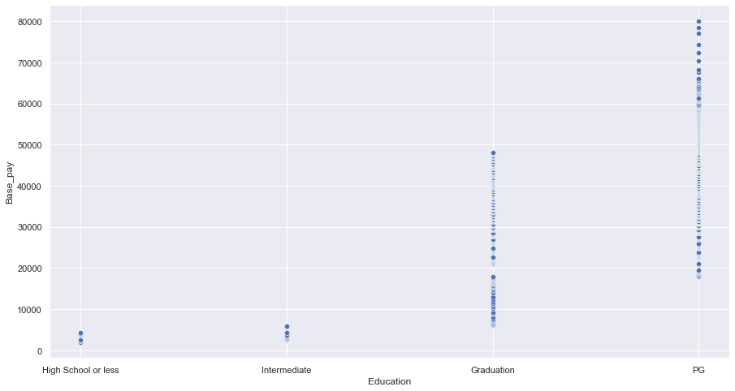
Bivariate Analysis- continued
Sale volume vs Bonus
Education vs Basic Pay
We observe that the unit sales less than or equal to 20, bonus is set to be below 4,000 and for Unit Sales of above 20, there is greater impact in bonus according to sales made.
We infer that employees with higher educational qualifications are offered with better basic pay.

Slide 7
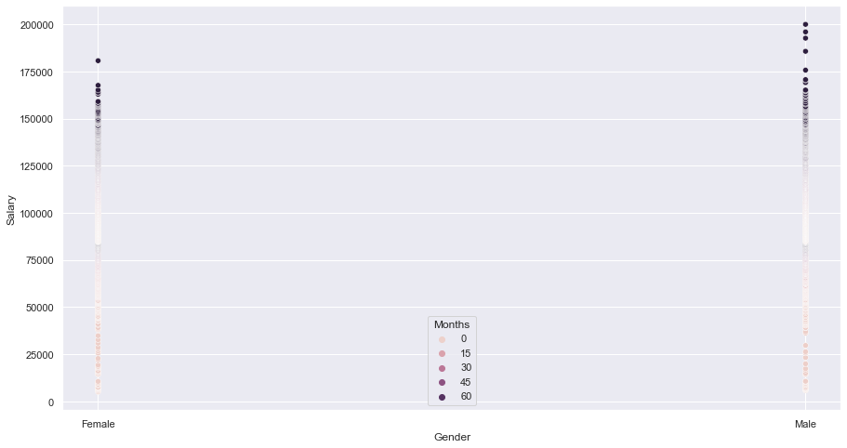
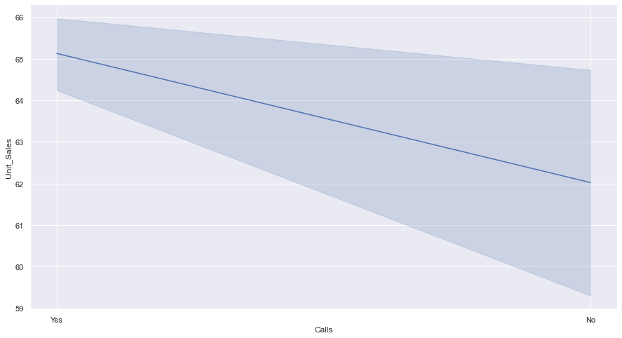
Bivariate Analysis- continued
Gender vs Salary
Calls made vs Sales
We infer that number of female employees are less than male employees in the company, salaries are equally distributed among both the gender
We infer that calls are beneficial for unit sales.

Slide 8
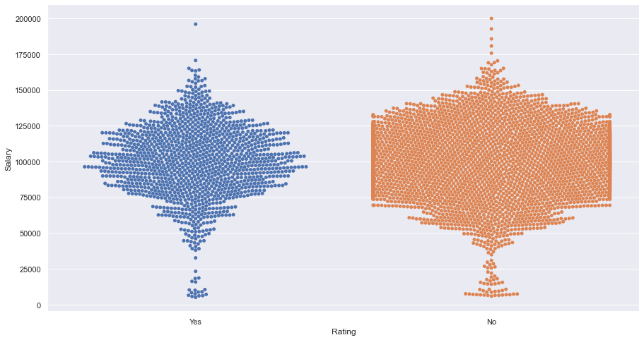
Bivariate Analysis- continued
Rating vs Salary
we can infer that rating doesn't affect the salary

Slide 9
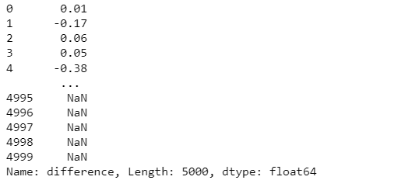
Bivariate Analysis- continued
Salary vs Difference in balances
Since there are null values we were unable to plot the graph between difference and salary columns. Once preprocessing is done we can plot the graph.

